Slide 1


SECURE SOFTWARE DEVELOPMENT (SSD)
Diploma in CSF
Academic Year (AY) 20/21 – Semester 3 (April `20)
Week 7
Secure software Design – Part 3 (threat modeling)
Last Updated: 29/05/2020

Slide 2
Contents
Threat Modeling
Mission 7.1: Threat Modeling Case Study
Mission 7.2: Razor Pages Security IV
Remote Learning Instructions

Slide 3
Remote Learning Instructions
Step 1
Read Threat Modelling
Details in slide 4-13
Step 2
Do Mission 7.1 and submit in Teams
More details in slide 14
Step 3
Do Mission 7.2 and submit in Teams
More details in slide 15

Slide 4
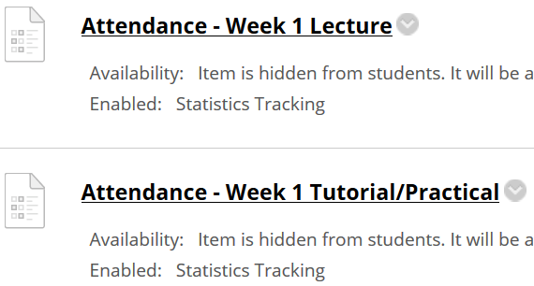
Important Details
VERY IMPORTANT
Visit MEL to start each week’s lesson. Learning materials will ONLY be released in MEL
Attendance Poll Attempt TWO attendance polls every week Starts Monday (9am) till Friday (11:59pm) Attendance :– Week x Lecture ( x refers to week number) Week x Tutorial/Practical Just click “Save and Submit”
Always lookout for announcements Do keep abreast of announcements in MEL
In light of the Covid-19 situation, your cooperation in adhering to the points mentioned is much needed and greatly appreciated.

Slide 5
Threat Modeling
Threat modeling is extremely crucial for developing hack-resilient software.
It is a systematic, iterative, and structured security technique during the design phase of a software development project.
It provides the software development team an attacker’s or hostile user’s viewpoint, as the threat modeling exercise aims at identifying entry and exit points that an attacker can exploit.

Slide 6
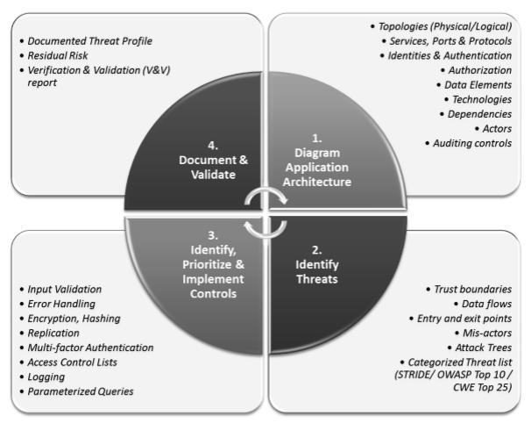
Threat Modeling Process
Threat Modelling includes the following phases in sequential order:-
Model Application Architecture
Identify Threats
Identify, Prioritize and Implement Controls
Document and Validate

Slide 7
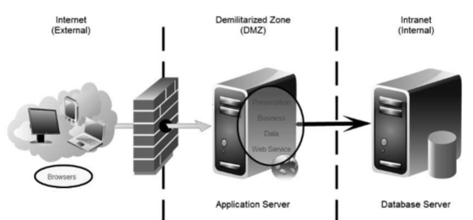
Threat Modeling: Model Application Architecture
3-Tier Architecture
End Users from Internet (External) access application hosted in DMZ with data stored inside the organization Intranet (Internal). | Browsers are usually used to access application logic (services) that processed and stored data into the database. This logical separation of 3-Tiers can occur in a single PC/laptop.

Slide 8
Threat Modeling: Identify Threats
Identify Entry Points:
Entry points are those items that take in user input. Each entry point can be a potential threat source and so all entry points must be explicitly identified and safeguarded. Entry points in a web application could include any page that takes in user input. Some examples include the Search page, Logon page, Registration page, Checkout page, Account Maintenance page, etc.
Identify Exit Points
Exit points are those items that display information from within the system. Exit points also include processes that take data out of the system. Exit points can be the source of information leakage and need to be equally protected. Exit points in a web application include any page that displays data on the browser client. Some examples are the Search Results page, Product page, View Cart page, etc.

Slide 9
Threat Modeling: Identify Threats
Determine Potential and Applicable Threats to these entry and exit points.
The two primary ways in which threats and vulnerabilities can be identified are:
Think like an attacker (brainstorming and using attack trees).
Use a categorized threat list.

Slide 10
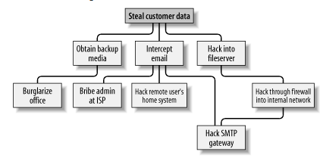
Threat Modeling: Identify Threats
Think like an attacker (brainstorming and using attack trees).
Reference: http://etutorials.org

Slide 11
Threat Modeling: Identify Threats
Use a categorized threat list.
STRIDE is an acronym for a category of threats. Using the STRIDE category threat list is a goal-based approach to threat modeling because the goals of the attacker are taken into consideration

Slide 12
Threat Modeling: Identify Threats
For each
Entry point / Exit Point / Feature / Sub-Feature
Think like an attacker
Draw an attack tree
Apply STRIDE

Slide 13
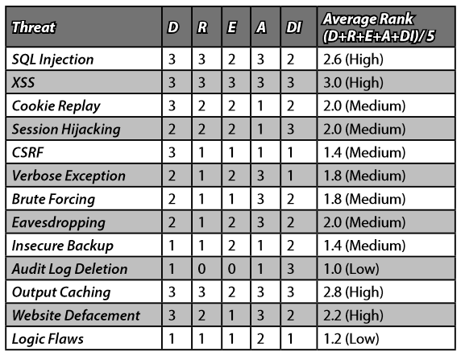
Threat Modeling: Identify, Prioritize and Implement Controls
Both average ranking and P x I ranking methodologies to rank threats were applied and the results tabulated.
Thereafter, apply the corresponding control and countermeasures related to the ranked threats. (Apply control measures on the highest threat first)

Slide 14
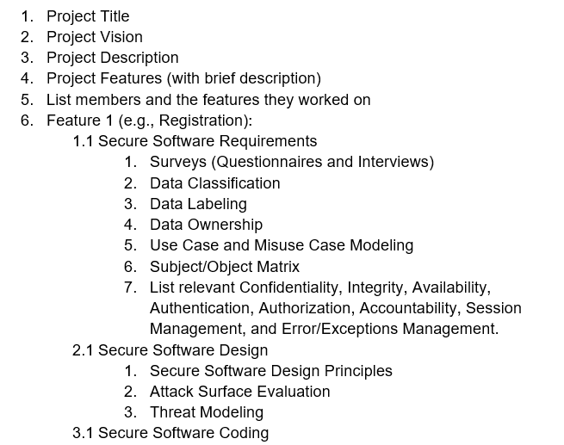
Threat Modeling: Document and Validate
Document the threat modelling process.
Validate the control measures applied are effective.

Slide 15
Open-Ended Question
Qn 1: Modelling for threat is not necessary for web application that is small in size (eg; 2-3 functions/features only). Do you agree? Support your argument.
Attempt the open-ended questions above.
Submit your answers in Teams group.
SSD-AY2021-xxx-Pxx → Week 7
Use “Conversations” tab under “SSD-AY1920-xxx-Pxx → Week 7” to discuss within your class group.

Slide 16
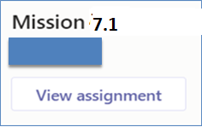
Mission 7.1 – Threat Modeling
Go through the following reference materials :
In MEL (Week 7)
Threat Modeling.pdf
DREAD.pdf
Average ranking
Probability x Impact (P x I) ranking
Apply the threat modeling learnt in the reference materials to the “sBooksPteLtd-CaseStudy”. Case study can be found:
In MEL (Week 7)
sBooksPteLtd-CaseStudy.pdf
Refer to the misuse cases in Week 4 (refer to Week 4 Mission).
Produce the followings for the misuse cases:-
attack tree and/or STRIDE
DREAD and
control measures
Submit answers in Assignment Submission.

Slide 17

Mission 7.2: Razor Pages Security IV (Individual)
Attempt the Razor Pages Security IV practical
Click on “Files” tab and download the “Razor Pages Security 4 v4.pdf”
Submit detailed screenshots of your completed practical page in Teams (General →Assignment (Mission 7.2 Razor Pages Security IV)).
The screenshots must show the browser’s “Address Bar” to verify the application is running in your laptop.
Deadline: End of Week 7
Penalty for late submission
If you got any issues or suggestions regarding Mission 7.2
Use “Conversations” tab under “SSD-AY2021-xxx-Pxx-Txx → Week 7” to discuss within your team.
Use “Conversations” tab under “SSD-AY2021-xxx-Pxx → Week 7” to discuss within your class group.
Tutors would also monitor these “Conversations”.

